Slide 1

Getting Started with PowerPoint
By:
Nikhil Gupta

Slide 2
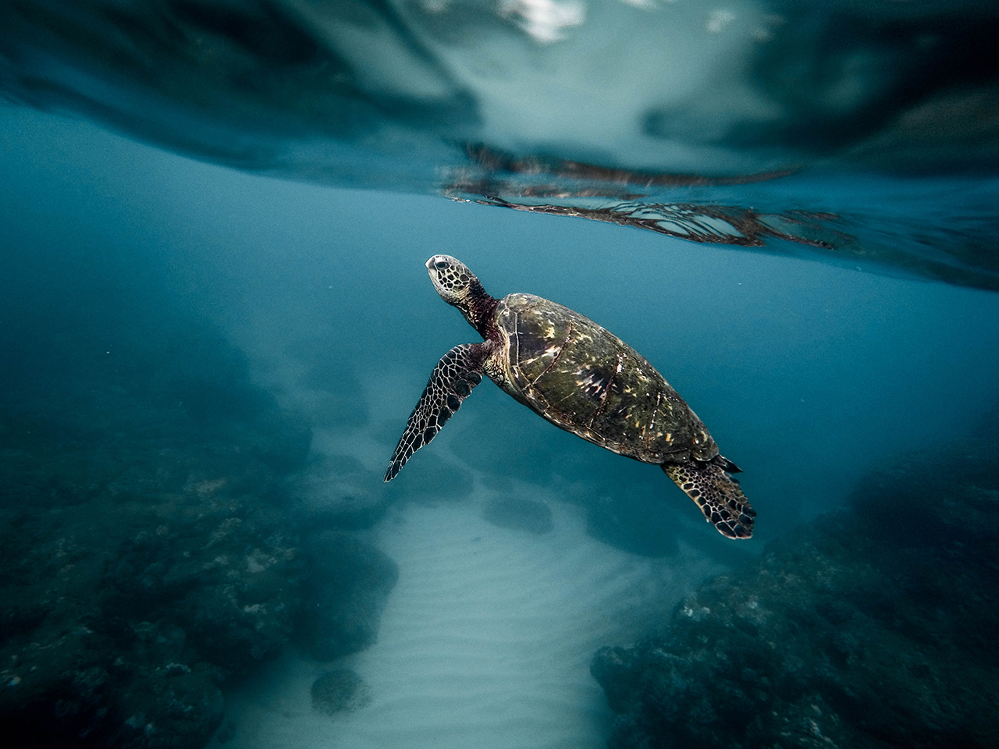
CLASSIFICATION

Slide 3
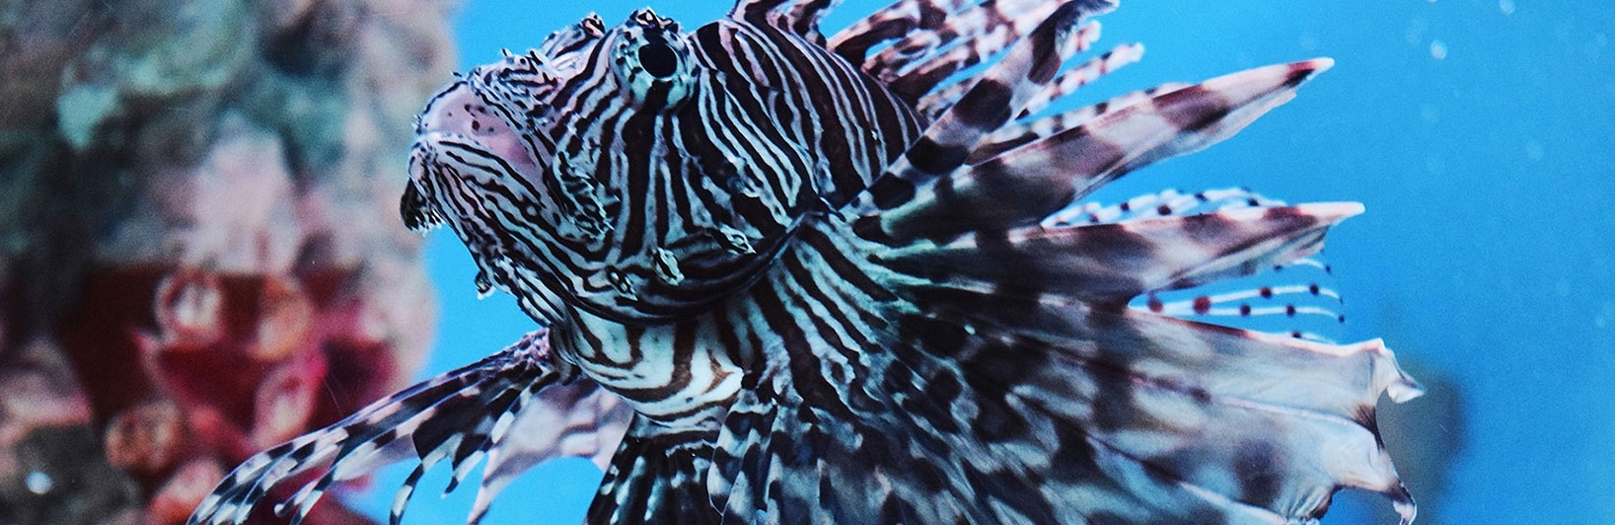
ABALONE

Slide 4
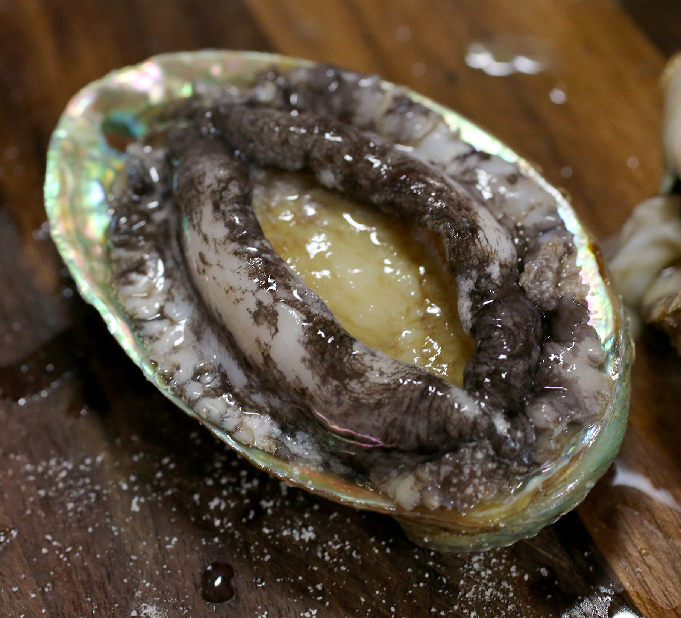
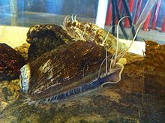
What’s an Abalone?
Abalone are a type of gastropod shellfish.
Abalone are known by their colorful inside shell.
Abalones are found all over the world.

Slide 5

What is this project about?
Finding the age of an Abalone using its physical characteristics.
5

Slide 6
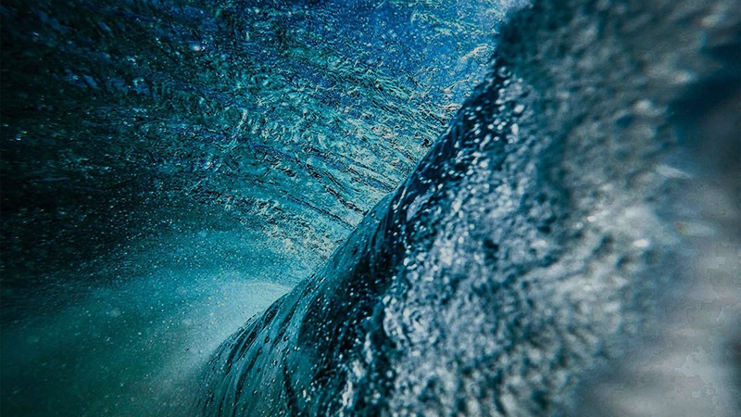
The Dataset : Abalone
6

Slide 7
Abalone - A Classification problem
UCI repository-Abalone
Attributes : 08
Instances : 4177
Datatypes : Multivariate

Slide 8
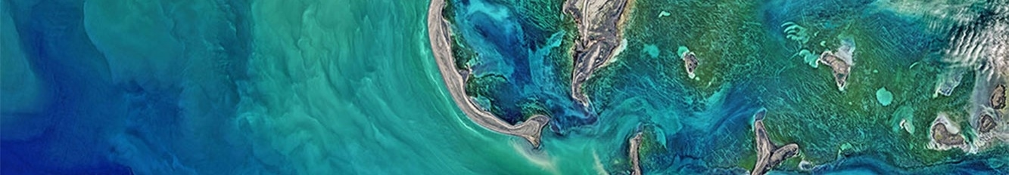
Target : To count no.of rings
Age of Abalone(in yrs)= No.of rings+1.5

Slide 9
Physical Characteristics:
Sex
Length
Diameter
Height
Whole Weight
Weight of meat
Viscera weight
Shell Weight
Rings

Slide 10
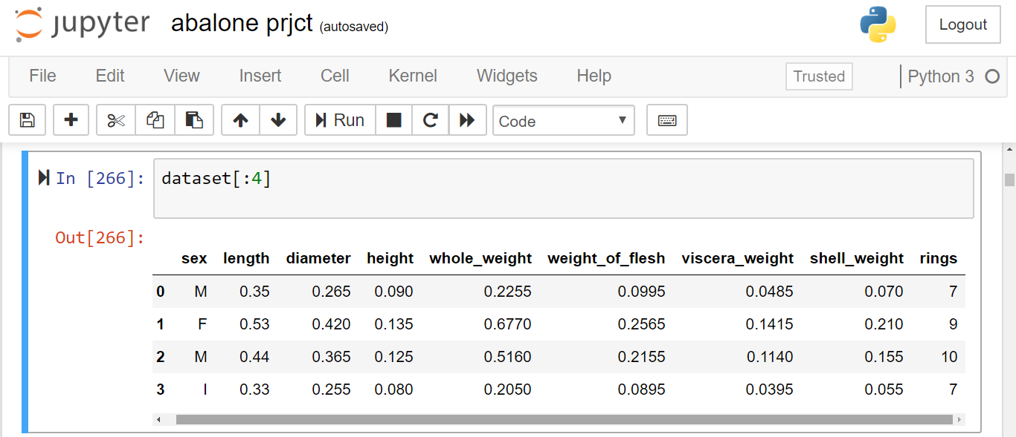
Dataset Examples

Slide 11
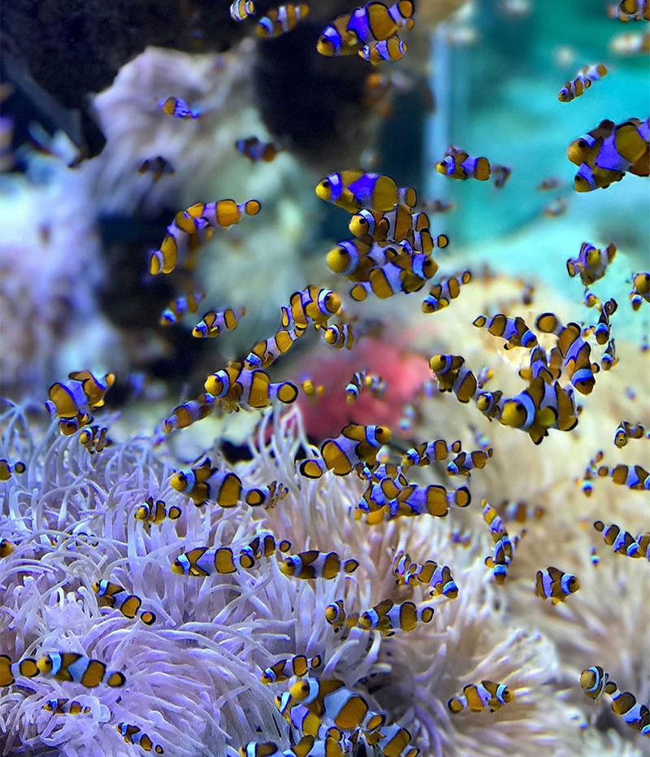
Methods in Classification:
Logistic Regression
K-Nearest Neighbors
Decision Tress
Support Vector Machine
11

Slide 12

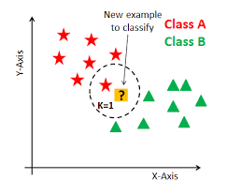
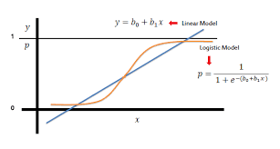
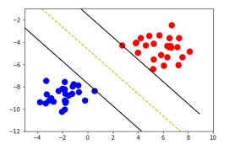
Brief view
Logistic Regression
K-Nearest Neighbour
Support Vector Machine

Slide 13
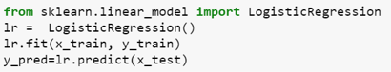
Logistic Regression
Definition: Logistic regression is a machine learning algorithm for classification. In this algorithm, the probabilities describing the possible outcomes of a single trial are modelled using a logistic function.
Advantages: Logistic regression is designed for this purpose (classification), and is most useful for understanding the influence of several independent variables on a single outcome variable.
Disadvantages: Works only when the predicted variable is binary, assumes all predictors are independent of each other, and assumes data is free of missing values.

Slide 14
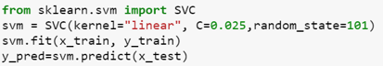
Support Vector Machine
Definition: Support vector machine is a representation of the training data as points in space separated into categories by a clear gap that is as wide as possible. New examples are then mapped into that same space and predicted to belong to a category based on which side of the gap they fall.
Advantages: Effective in high dimensional spaces and uses a subset of training points in the decision function so it is also memory efficient.
Disadvantages: The algorithm does not directly provide probability estimates, these are calculated using an expensive five-fold cross-validation.

Slide 15
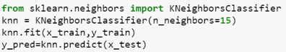
K-Nearest Neighbours
Definition: Neighbours based classification is a type of lazy learning as it does not attempt to construct a general internal model, but simply stores instances of the training data. Classification is computed from a simple majority vote of the k nearest neighbours of each point.
Advantages: This algorithm is simple to implement, robust to noisy training data, and effective if training data is large.
Disadvantages: Need to determine the value of K and the computation cost is high as it needs to computer the distance of each instance to all the training samples.

Slide 16
K NEAREST NEIGHBOR
Requires 3 things:
Feature Space(Training Data)
Distance metric
to compute distance between records
The value of k
the number of nearest neighbors to retrieve from which to get majority class
To classify an unknown record:
Compute distance to other training records
Identify k nearest neighbors
Use class labels of nearest neighbors to determine the class label of unknown record
?
16

Slide 17
k NEAREST NEIGHBOR
Common Distance Metrics:
Euclidean distance(continuos distribution)
d(p,q) = √∑(p_{i} – q_{i})²
Hamming distance (overlap metric)
Discrete Metric(boolean metric)
Determine the class from k nearest neighbor list
Take the majority vote of class labels among the k-nearest neighbors
Weighted factor
w =1/d(generalized linear interpolation) or 1/d²
bat (distance = 1) toned (distance = 3)
cat roses
if x = y then d(x,y) = 0. Otherwise, d(x,y) = 1
7
17

Slide 18
k NEAREST NEIGHBOR
k = 1:
Belongs to square class
k = 3:
Belongs to triangle class
?
k = 7:
Belongs to square class
Choosing the value of k:
If k is too small, sensitive to noise points
If k is too large, neighborhood may include points from other classes
Choose an odd value for k, to eliminate ties
8
18

Slide 19
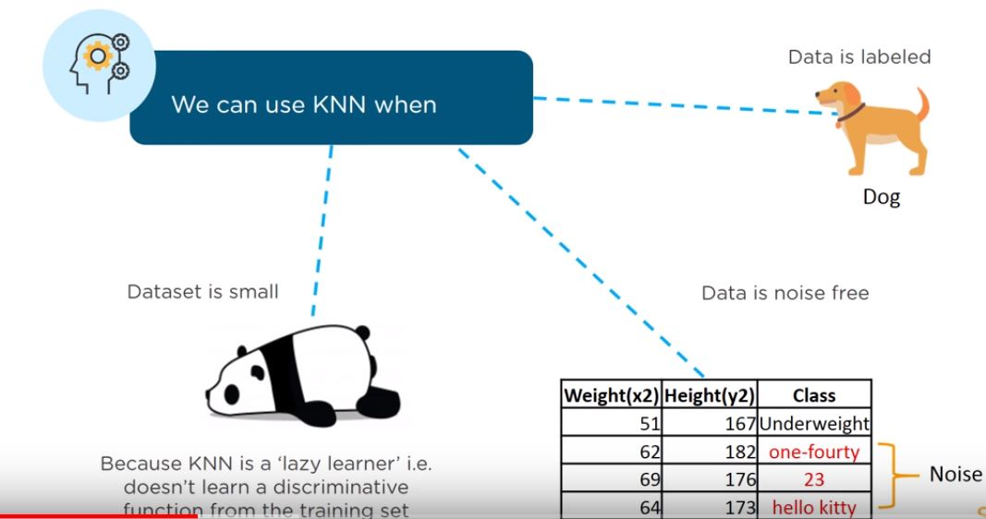
k-nearest neighbors algorithm (k-NN)

Slide 20
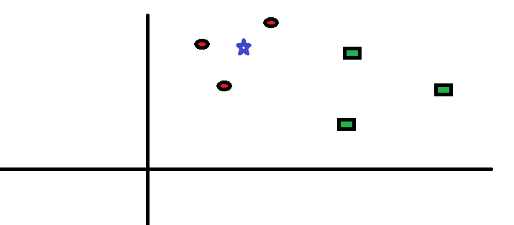
How does KNN actually work? * Let’s take a simple case to understand this algorithm. Following is a spread of red circles (RC) and green squares (GS) . * We intend to find out the class of the blue star (BS) . BS can either be RS or GS an nothing else. * The “K” is KNN algorithm is the nearest neighbors we wish to take vote from. * Let’s say K = 3. * Hence, we will now make a circle with BS as center just as big as to enclose only three datapoints on the plane. *

Slide 21
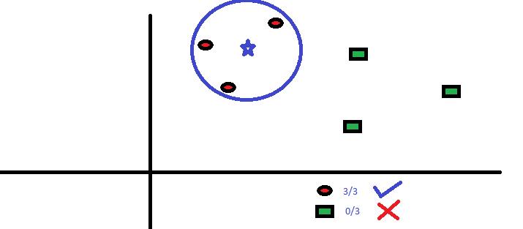
The three closest points to BS is all RC. Hence, with good confidence level we can say that the BS should belong to the class RC. Here, the choice became very obvious as all three votes from the closest neighbor went to RC. The choice of the parameter K is very crucial in this algorithm. Next we will understand what are the factors to be considered to conclude the best K.

Slide 22

Quote and Image Slide
“
You can have data without information, but you cannot have information without data.”
- Daniel Keys Moran
Computer programmer and science fiction author
22

Slide 23
THANK YOU
Insert Image

